Slide 1
Session 3.1 Logical Modelling - Normalisation
IN705 Databases 3 - 2018
Notes:
Based on Churcher, chapters 7-9

Slide 2
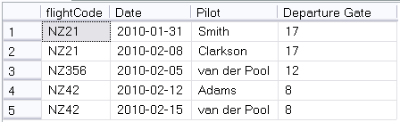
Update Anomalies
A situation where changing a record in the database (via insert, update or delete) causes an inconsistency with other records.
UPDATE Flights
SET gate = 71 WHERE pilot = ‘Clarkson’
Notes:
Look at this table.
It records the pilot of Air New Zealand filghts. Each flight always leaves from the same gate, but can have a different pilot in each instance
What is the primary key?
Not Flight code, that repeats
Not date, there could be two flights on the same day
Assuming that each flight goes only once a day (which is how it works), a good primary key is (flightCode, Date)
A given flight leaves each day from the same gate, as shown. Our data have integrity.
So now this update happens. This is perfectly legal. Gate is not part of the primary key, so the system will execute the update.
The gate is wrong, and we can’t tell which is correct 17 or 71
Anything about the constraints of the database that would prevent this? No.
This is an update anomaly. One of several types that can occur.
Such things can only happen when there are flaws in the design of your tables. Can you see the flaw here?
Perhaps you can, perhaps you can’t. But you don’t want to be in situations where you’re having to try to intuitively guess your table into shape. We’re going to look now at a process which, when followed, will guarantee (almost) that your tables can’t get into a bad state.

Slide 3
Normal Forms
Data quality violations are possible because of flaws in the table design.
The specific requirements for a table design that is not at risk have been determined.
They are called “normal forms”.

Slide 4
Normal Forms
There are five normal forms
1st, 2nd, 3rd (& Boyce-Codd), 4th & 5th
They are
Increasingly safe
Increasingly complicated to implement
Your databases should always be in at least” 3rd normal form.
If your tables are in the appropriate normal form, update anomalies and data entry errors cannot occur.
Notes:
Really 6, but two of them are just variations
If your database is mission critical, so that errors would be life and death, and you can’t stand putting any checking into the GUI, you can consider 4th and 5th Normal Form. Look it up if interested.

Slide 5
Normalisation
The process of putting your tables into the correct normal form is called “normalisation”.
Each normal form addresses a particular structural flaw
There is a two-step process for each normal form:
Detect the flaw
Fix the flaw
After you have constructed your logical model, you should work carefully through normalisation
Notes:
Each form has its own particular problem that you look for
There is also a detailed rule for fixing the flaw if you find it

Slide 6
Example
BIT Staff
BITStaff
staffName
staffOffice
staffEmail
staffCourse1
staffCourse2
staffCourse3
staffCourse4
Notes:
Lesley has this big spreadsheet for keeping track of staff, but it’s getting out of hand, so we make this nice little one-table database that holds all the information in her spreadsheet.

Slide 7
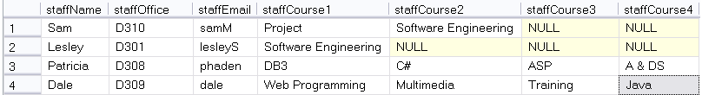
Example
Caution!
No attributes with multiple values (even if they’re pretending to be separate attributes)
Notes:
So here’s our little table.
There are a couple of issues here, like the Primary Key staffName might not be unique, and we’d have to enforce consistency on the names of the papers and so on, but let’s just concentrate on the table structure right now.
See any problems?
What query would you write if you wanted all the Software Engineering staff? You can see that for Sam it’s attribute course2 and for Lesley it’s course 1. To be sure, you’d have to make a big OR, which is messy.
But there’s worse than that. We need to add Dave to the database, but Dave teaches 5 papers this year. Oops.
These are both symptoms of the fact that staffCourse1 to 4 aren’t really four different attributes, they are one attribute (courses you teach) that has multiple values.

Slide 8
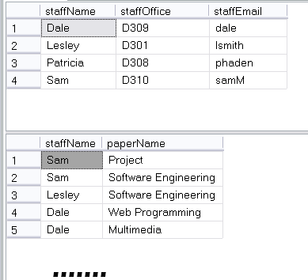
Example
Notes:
We’re seeing just a portion of the papers table here….
So now, how do we find all the SE staff? (Query Papers)
And can we add Dave? (Sure, just add 5 records to Papers)
Congratulations. You’ve put your table into First Normal Form

Slide 9
Example
To repair this problem
Remove the columns that represent the multiple-valued attribute
Give them their own table
Make each value in those columns a row in the new table
For each row add a foreign key that refers back to the record in the original table by its primary key

Slide 10
Example
BITStaff
 | staffName
 | staffOffice
 | staffEmail
Papers
 | staffName
 | paperName

Slide 11
First Normal Form
A table is in First Normal Form if
It has no multiple-valued attributes
There is no ordering to the columns
There is no ordering to the rows
There are no duplicate rows
Notes:
You will often see “multiple-valued attributes” called “repeating groups”. Same things
Technically, there are actually a few more rules about First Normal Form because it is really simply the base definition of what a relational table looks like
These other rules are rules, but nobody ever gets them wrong, so we don’t worry about “how to fix”
Note that the “no ordering to the rows” thing doesn’t mean you can’t sort it. It just means that it’s the same table, regardless of sort order. You don’t lose any data if the sort order changes.

Slide 12
First Normal Form
Flaw:
A table is not in 1st Normal Form if it is keeping multiple values for an attribute.
Fix:
Remove the multivalued information from the table.
Create a new table with that information, and the primary key of the original table.
Notes:
Most likely, with a little experience in data modelling, you won’t ever try to create a table that isn’t in 1st Normal Form.
But you know what to look for, and what to do.

Slide 13
Example
Enrollment
Student
studentID
studentID
instrument
lastName
grade
firstName
fee
Notes:
The Saturday Morning Music Classes in Dunedin have hundreds of students, both child and adult.
They teach all different instruments at all different grades
The fee structure is based on instruments (recorder is cheaper than trombone because of the teacher/student ratio required)
Here’s the database they use to record their enrolment information.
You can see they have separate fields for lastName and firstName. The studentID is an IDENTITY field so must be unique.
It therefore correctly serves as a foreign key in Enrollment
Here are some data values in

Slide 14
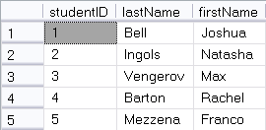
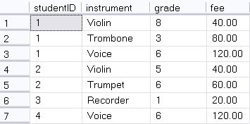
Example
UPDATE Enrollment
SET fee = 50
WHERE studentID = 1 and instrument = 'Violin'
Notes:
This structure looks pretty good.
Think about the questions we might want to ask, and make sure we can ask them
Can you list all the violin players together?
Can you tell how much money Joshua Bell owes? If you knew his ID number? If you didn’t?
So, where is there a problem with this database?
Look at this query
Is it legal? (i.e. does it violate any constraints, here specifically the foreign key or record uniqueness?)
So the system will allow it. It is a perfectly ok query.
But what is the result?
Joshua will pay 50.00 for his violin lesson and Natasha will pay 40 for hers. Looking at the database, can anyone tell which was the error and which is correct?
This is an update anomaly (modification) causing a data uniqueness error

Slide 15
Example
DELETE Enrollment
WHERE instrument = ‘Trombone’
AND studentID = 1
Notes:
How about this one?
Legal?
Consequence? You no longer have any record of the fee for Trombone. Joshua was the only student taking it, and because he dropped it, you lost that piece of information.
This is an update anomaly (deletion)
So this particular table is at risk of both modification and deletion anomalies (insertion too, if there’s a data entry error on fee….)
Can you see, intuitively, what the problem is?
To understand formally what this error is (which will allow us to establish an orderly process for fixing it) we need to look carefully at what’s happening with the primary ketys….

Slide 16
Example
Student(studentID, lastName, firstName)
Enrollment(studentID, instrument, grade, fee)
What is the primary key of Enrollment?
Notes:
Recall that the primary key must be unique for every record, guaranteed
studentID? No, the same student can take multiple instruments
Insturment? No, there are lots of duplicates?
And obviously not grade and fee, no uniqueness there.
If no single key can be primary, look to combinations of keys.
(Assuming that we aren’t keeping any historical record of grade) What combination will be unique?
studentID and instrument. There would be no meaning to listing the same student/instrument combination twice. This makes a good primary key

Slide 17
Example
Student(studentID, lastName, firstName)
Enrollment(studentID, instrument, grade, fee)
What is the primary key of Enrollment?
For all the non-primary fields, what fields determine them?
Grade is determined by studentID and instrument
Fee is determined by only instrument
Notes:
Let’s think now about what a primary key is supposed to tell us.
The primary key is the unique identifier of a record. So technically, the primary key of a record should determine all the other values. Meaning, if you know the value of the primary key, you know the value of all the other fields.
E.G. your student ID number determines your name and address, and so on. My name determines my office. The paper and stream determines the classroom. Your address determines your postcode, etc.
Looking back at our table, for each of the non-primary keys, what fields determine them. That is, what fields would you have to know to be able to tell their value
Grade <- studentID and instrument. You can’t tell the grade unless you know both the student and the instrument
Fee is determined by only instrument. You don’t have to know the student to know the fee. It is only based on the instrument, and that is the problem

Slide 18
Definition
Functional Dependence
If A and B are two fields in a relation and A uniquely determines B
B is functionally dependent on A
A → B
In our example
(studentID,instrument) -> grade
Instrument -> fee

Slide 19
Caution!
You should never have a table where
The primary key is composite, AND
Any field is functionally dependent on only some of the fields making up the primary key
Such a table will be at risk of update anomalies.
Uniqueness of the primary key is not enough to guarantee correct values for all the other fields.
Notes:
This is exactly the problem in our table.
Our primary key is (studentID, instrument) but the fee field is only functionally dependent on instrument.

Slide 20
To Fix This Problem
Pull the partially dependent columns out into their own table.
Make the part of the primary key they depend on their new primary key.

Slide 21
To Fix This Problem
Student
Instrument
studentID
instrument
lastName
fee
firstName
Enrollment *
studentID
instrument
grade
Notes:
Now.
Are all field in Student FD on all elements of their PK?
Instrument?
Enrollment?
Congratulations, you’ve got second normal form

Slide 22
Second Normal Form
A table is in 2NF iff:
It is in 1NF
All non-key fields are functionally dependent on all parts of their primary key

Slide 23
Second Normal Form
Flaw:
Some non-key column is functionally dependent on only a subset of the fields which comprise the primary key
Fix:
Remove the non-key fields that are not dependent on the whole primary key
Make a new table with all these fields and the part of the primary key they depend on as the new primary key

Slide 24
Question
If a table is in 1NF and uses an auto-incrementing IDENTITY variable as a primary key, must it also be in 2NF?
Notes:
Yes. If the primary key is only one field, nobody can be FD on part of it.
Let’s look now at those update anomalies we had before

Slide 25
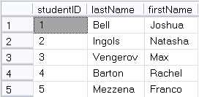
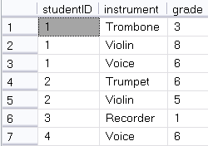
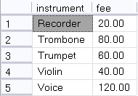
2NF
Notes:
Can you still answer all the questions you want to know?
All the violins? Yes.
How must Max owes? (A 3-table join now)
Is it now possible for Joshua and Natasha to be charged a different amount for Violin lessons? No.
If Joshua decides to drop the Trombone, do we still know what the fee for Trombone is? Yes.

Slide 26
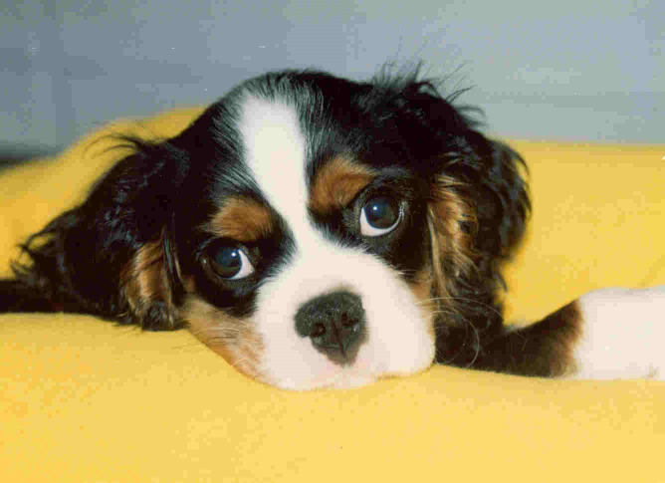
Example

Slide 27
Example
CavEvent
eventID
eventDate
eventLocation
eventJudge
dogName
dogOwner
Notes:
You’re keeping track of winning Cavalier King Charles Spaniels in dog shows

Slide 28
Example
EventID | Day | Location | Judge | Dog | Owner
1 | 2/10/2009 | Westminster | Beth Sweigart | Ch Timsar Mister Moonlighter | Cindy Huggins
2 | 30/09/2009 | Inglison | Robert Waddington | Ch Nottus Hooray Henry | James Jackson
3 | 8/11/2009 | Higham | Michale Forte | Ch Cinderlace Cromwell | Albert Vella
4 | 12/12/2009 | Los Angeles | Beth Sweigart | CH Pinecrest Rock The Boat | Margaret duBois
5 | 14/06/2009 | Bristol | Vladimir Lizorov | Ch Timsar Mister Moonlighter | Cindy Huggins
6 | 20/02/2009 | San Diego | Paula Mitchell | CH Pinecrest Rock The Boat | Margaret duBois
7 | 11/01/2009 | Boston | Kevin Sherman | CH Anberran Ginger Truffle | Evan Mondrian
8 | 9/03/2009 | Edinbirgh | Vladimir Lizorov | Ch Timsar Mister Moonlighter | Cindy Huggins
Notes:
No repeating values, so this is in 1NF
A non-composite primary key, so it’s in 2NF
So, no problems?
See the trouble? What happens when Cindy Higgins sells Timsar Mister Moonlighter?
You would have to change all the occurrences, which, like code duplication in programming, is just asking for data inconsistencies to be introduced
And, if you have a big database with all the dozens of shows each dog has won? The mess is just worst.
So based on your understanding of the whole database thing now, what would you suggest?

Slide 29
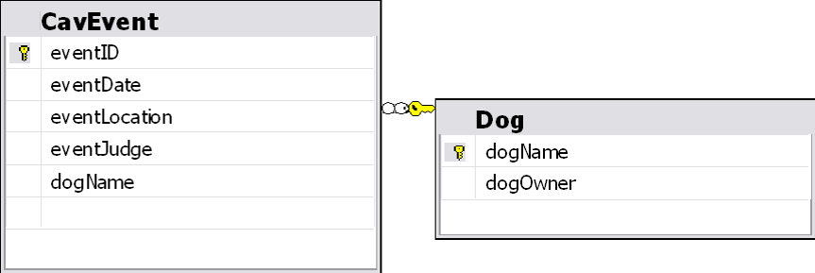
Example
Notes:
Pull out the dogOwner column into its own table, and make dogName the FK
What looked wrong? The repetition of the owner value?
It’s good if you can tell by looking what the problem is, but in a 100 table database, you don’t want to be counting on that.
Let’s look at what’s going on here….
The problem can be seen by looking at the functional dependencies.

Slide 30
Example
EventID Primary Key
Day Event ID
Location Event ID
Judge Event ID
Dog Event ID
Owner Dog
Notes:
Who depends on what? That is, what value would you have to know to be able to figure out each column
And there is your problem.
Note that you could tell who the Owner is from the Event ID, but you could also tell who the Owner is without it.
If you know the Dog, you know the Owner, regardless of what day or show or anything else
Therefore Dog->Owner, and if Dog changes you’re in trouble

Slide 31
Example
Dog -> Owner
Dog is not a primary key
Therefore, you can have repeated instances of Dog in the table
In which case you will have repeated instances of (Dog, Owner) in the table
If (Dog, Owner) changes, you must update all repetitions

Slide 32
Caution!
If any column is functionally dependent on a non-primary key your table is at risk of update anomalies.
Notes:
Get rid of them, and you’ve got 3rd normal form

Slide 33
Third Normal Form
Flaw:
Some column is functionally dependent on a non-key column.
Fix:
Pull the dependent column out into its own table. The column on which it depends becomes it primary key.

Slide 34
Make Robust Tables
1NF:
Remove repeating values
2NF:
Remove any functional dependencies on partial primary keys
3NF:
Remove any functional dependencies on non-primary keys
Notes:
Usually your tables will start out in 1NF. So it just becomes a process of looking at the FD of every column in every table.
With practice, you’ll be able to see these problems well.

Slide 35
Make Robust Tables
“Your data should depend on the key (1NF), the whole key (2NF) and nothing but the key (3NF)”

Slide 36
Avoiding Normal Form Violations
It’s good to be able to spot NF violations and fix them.
It’s better for them never to occur in your logical model at all
Many can be avoided through careful conceptual modelling
Notes:
In fact, many of the problems in the examples we saw today would never have come up in any model you would have made.
You would probably just automatically have made a tblDog with all the dog dependent information in it

Slide 37
Avoiding Normal Form Violations
Describe, in one word, the common feature of all the flaws….
….redundancy
Each entity in your conceptual model should describe one thing
Each piece of information in your conceptual model should be in one place
Notes:
All the bad things happened because data was repeated in the table (or some flavour of that)
What is this like in OO? (High cohesion, low coupling)

Slide 38
Exercise
Notes:
Handout
ERD conversion task
Normalisation task (theatres)
This is a checkpoint

